Slide 1

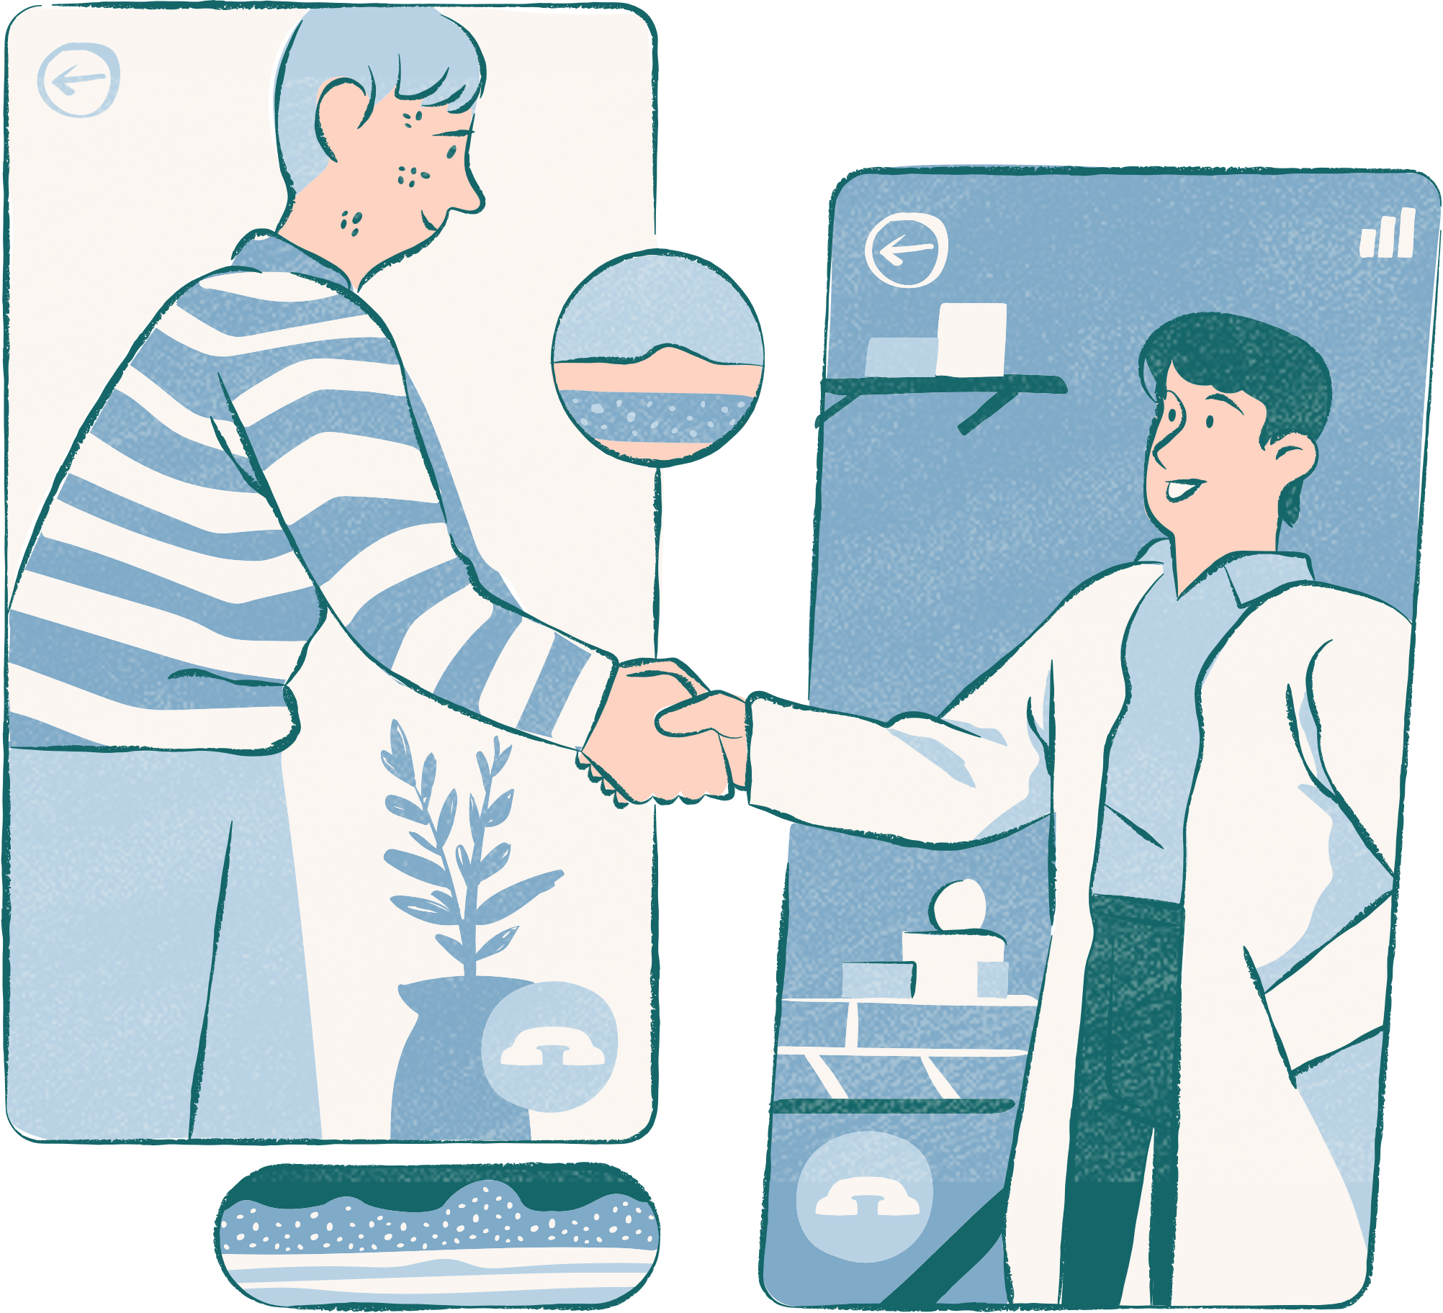
HealthXplorers
Your health, our mission
Addressing every need

Slide 2
Problem Statement
Developing a Unified Patient Treatment Platform
for Healthcare Advancement

Slide 3

Introduction
The developers- Karthik V(Team lead) and Sumedh Kudale have worked on this project. This project comes under healthcare track. We are commited to the well-being of mankind. We have developed a fully working digital product made in 48Hours

Slide 4

Timeline of Digital product Development

Slide 5
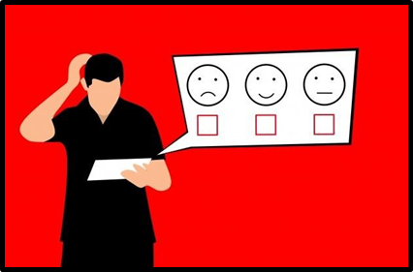
We have gone through each of the development phase of a product just as for any real world product Pre Launch Survey
DAY 01 -
survey is designed to gather insights, opinions, and preferences from potential users or customers before the product is officially launched.

Slide 6


INTRODUCING
HealthXplorers

Slide 7
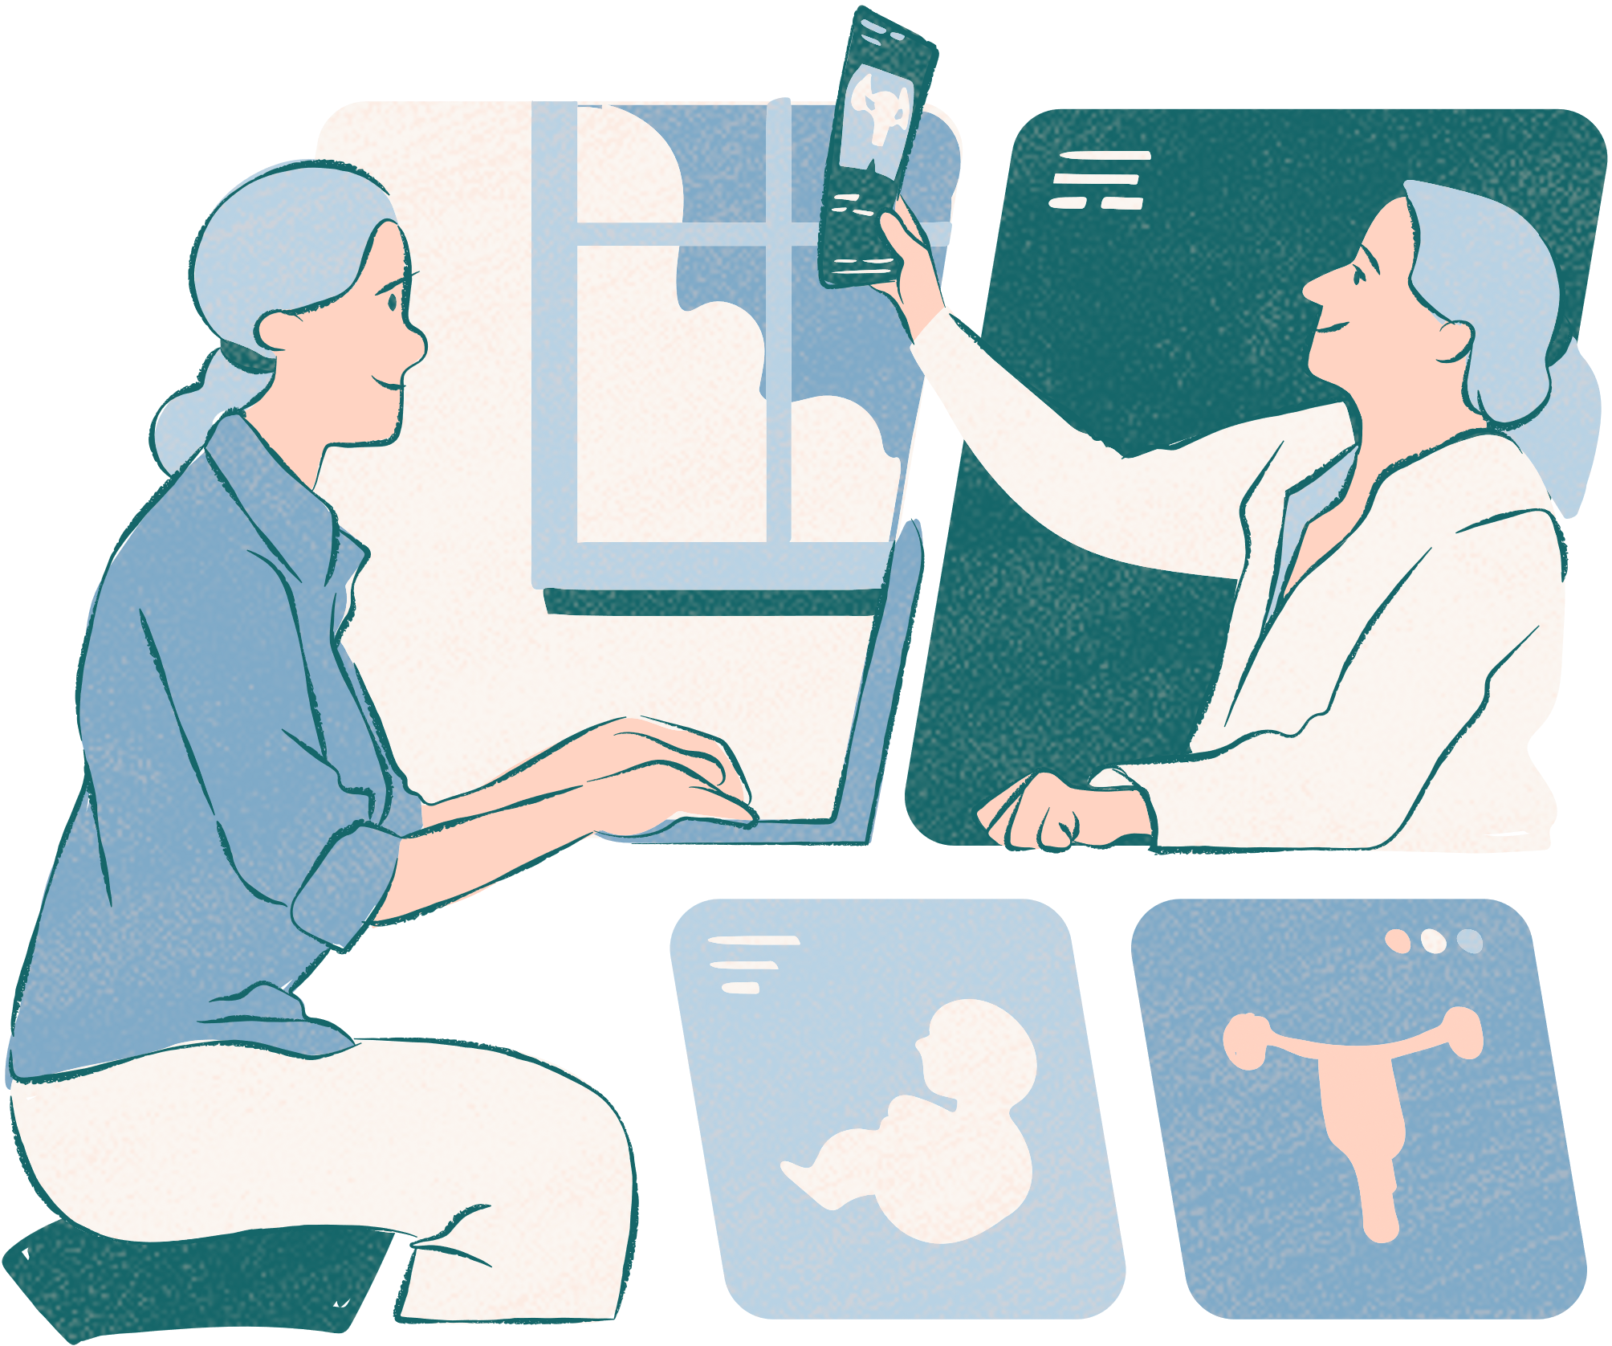
Idea Overview
We have created a UPTP with the following features:
Patient Centric Access
Allows real time updating
Can be integrated with Health Level 7 standard data

Slide 8
Idea overview
Services
01.
02 .
Data system:
Can register to create different profiles for patients
Can store the patients medical details along with photo
Patients or doctors can login to see/edit profiles
Password protected
Health Level 7 file converter:
Can convert Health level 7 messages to csv or excel for importing to database
Can also convert csv or excel to Health level 7 messages for exporting data

Slide 9
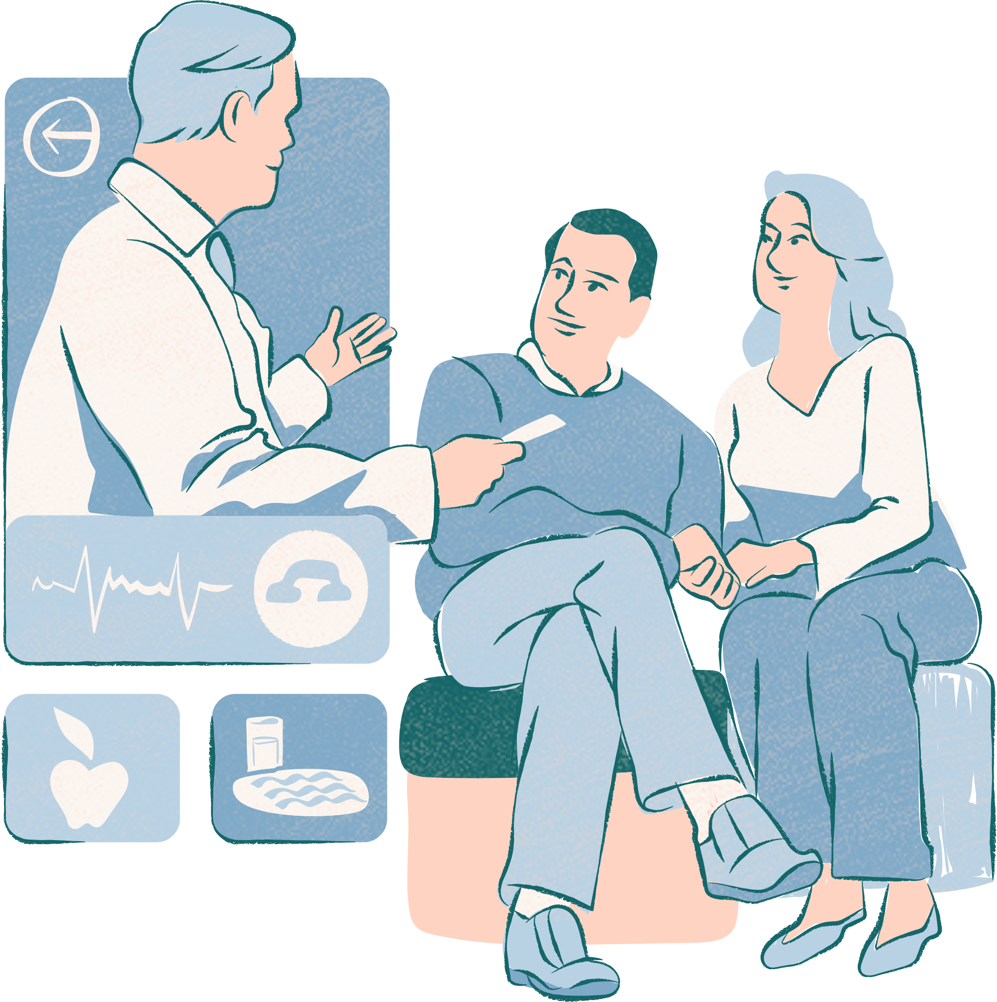
Technical Overview
Following technologies were used in this project:
Django with Python
HTML,CSS,JavaScript
SQLite Databases

Slide 10
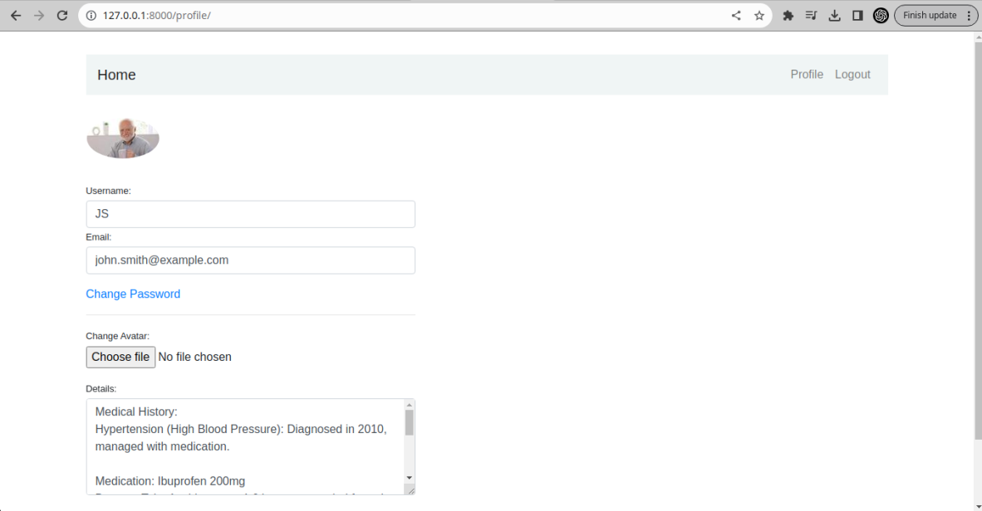

Slide 11
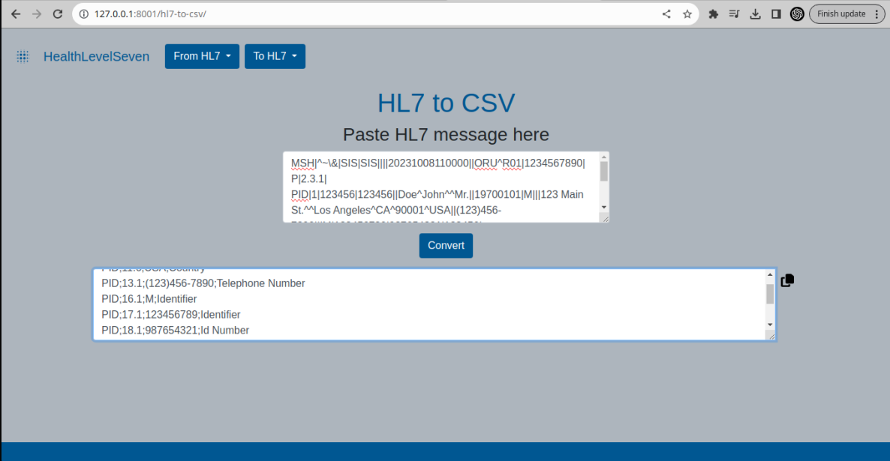
Execution

Slide 12

Future Scope/
Market Prospects
-The system is already capable of storing as many number of profiles as needed.
-The Health Level 7 conversion system can be integrated into the profile application to upload data directly.
-Image analysis can also be used in the profile application for medical analysis as soon as image is uploaded.

Slide 13
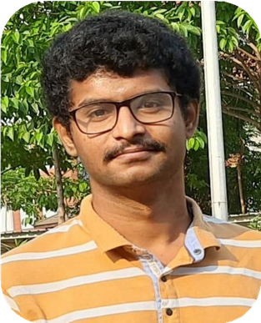
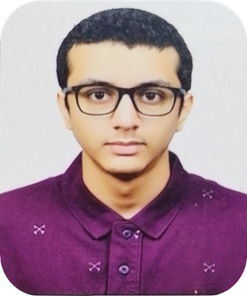
Our Developers
Dedicated professionals
Karthik V
Sumedh Kudale

Slide 14
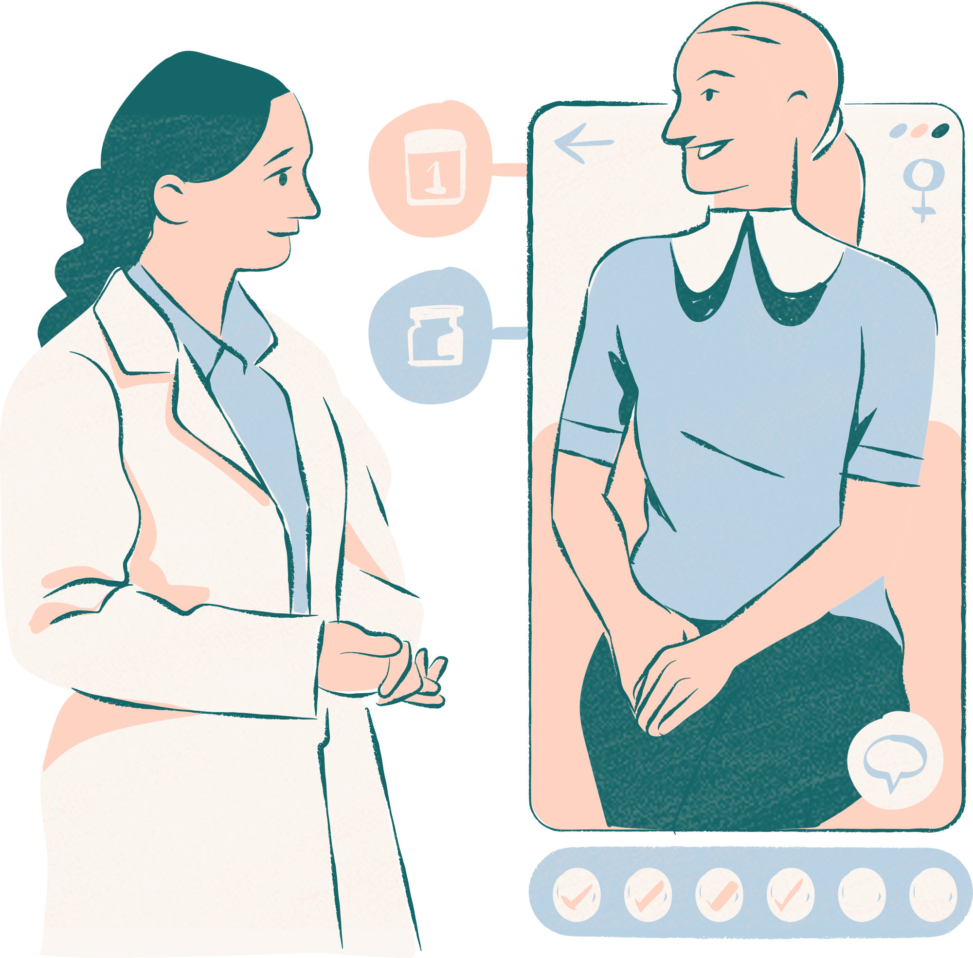
HealthXplorers
Thank you very much!

